Slide 1
Brighton High ACT 2024
March 20, 2024
Report to Brighton at 7:00 AM for Check-In

Slide 2
Your ACT Code
Go to myact.org
Click Create MyACT Account
I registered or tested before
Click “I have never accessed my scores before”
Fill out the form, your ACT ID is on the label outside this packet
This links any prior or future ACT test you will take as well as get access to your score when they are released, otherwise you will have to wait at least 2 weeks after to get your score
Easy access into the testing portal day of the test!

Slide 3
Important Info
When: WEDNESDAY, MARCH 20, 2024
Time: 7:35 A.M. to 11:30 A.M.
Where: Brighton High School
Room Assignments TBA
Who: 11th Grade Students ONLY

Slide 4
Why take the ACT?
-College Admission Entrance Required for some colleges
-Scholarship criteria
Save thousands on tuition with new or increased scholarships
-Class placement in college courses
Save money by being placed in the correct class rather than taking remedial classes
A high science score shows STEM readiness
The ACT is accepted by all US Colleges and Universities
ACT comes with 4 free score reports and a Superscore (your best score in each section from each time you take the ACT)

Slide 5
What to bring to the ACT?
Photo ID:
Must bring current photo ID issued by the school or state/government
School issued chromebook.
No personal computers
Fully charged or bring charging cable
Test program is called TestNav and allows for you to do a practice test on the chromebook
Calculator
Included in the packet is the list of approved devices
The room proctor/monitor will be checking devices.

Slide 6
You can also bring these optional items
Snacks and water bottles are allowed in the room under your desk.
Must be consumed out of the room during the break.

Slide 7
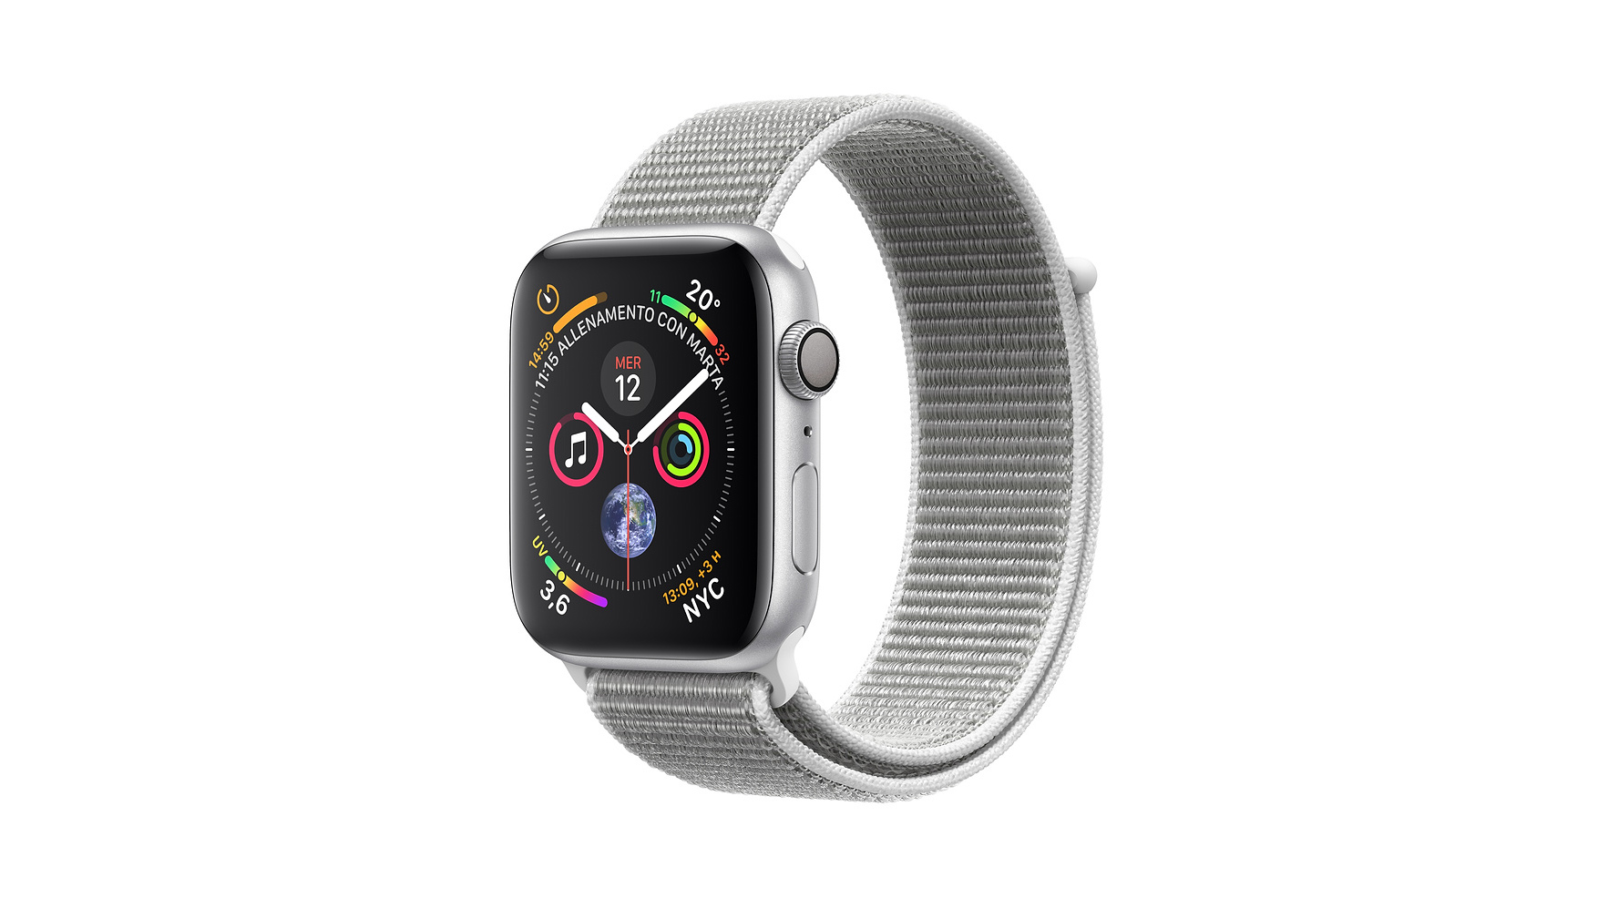
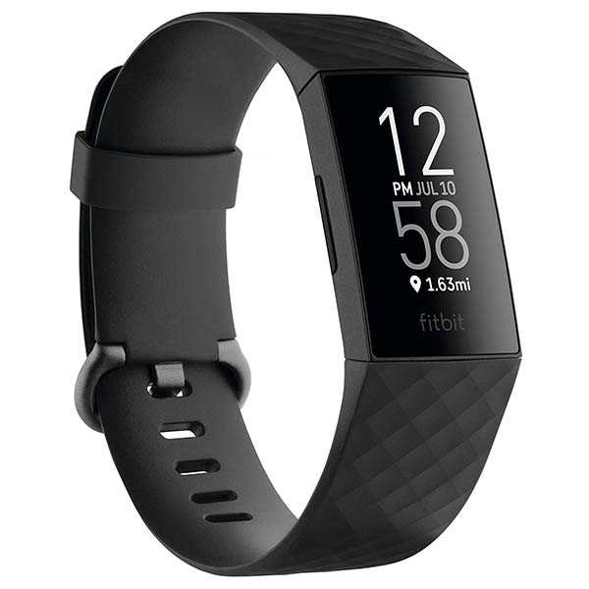
DO NOT BRING THESE ITEMS
If you bring any of these items into the room your test maybe canceled
Cellphones
Smart watches
Non school issued laptops
Anything capable of an internet connection
Do not bring pens, highlighters
Reading material
Scratch paper, notebooks, dictionaries
Be safe, than sorry and store these items in your car, your locker, the office, a non-participating teachers room

Slide 8
Breakdown of the Test
4 Sections
Reading (35 minutes, 40 questions)
English (45 minutes, 75 questions)
Math (60 minutes, 60 questions)
Science (35 minutes, 40 questions)
Score 1 – 36
18 is needed for Seal of Biliteracy English Requirement
For the Honors Diploma
English - 18
Reading – 22
Math – 22
Science - 23

Slide 9
ACT Prep Classes
$35
Online Canvas course
Pay in the Main Office

Slide 10
Shmoop Free Test Prep

Slide 11
Day of Test
Eat a good breakfast, put away phones and smart watches in car/locker
Report at 7:00 AM with the 3 essentials (ID, Chromebook, and Calculator)
It will take time to check everyone in.
A snack will be provided but if you have a favorite bring your own
Classroom doors will open at 7:30
Test starts at 8 AM
Test ends at 11:30 for most students
Lunch will be served at 11:30 for all students
Teachers will be available for consultations around 12:30

Slide 12
You’ve got your score, now what?

